Slide 1
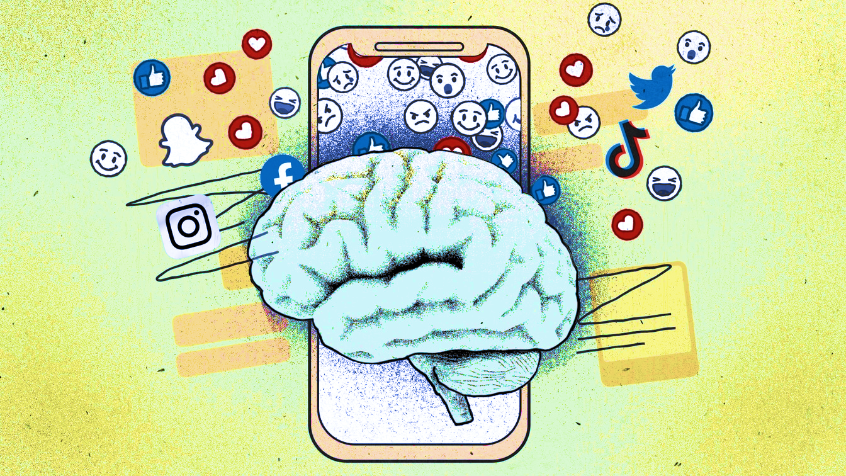
The influence of social media usage on cognitive control and risk-taking
School of economics and business,
University of Ljubljana
Ljubljana, 2024
Brigita Milanič

Slide 2
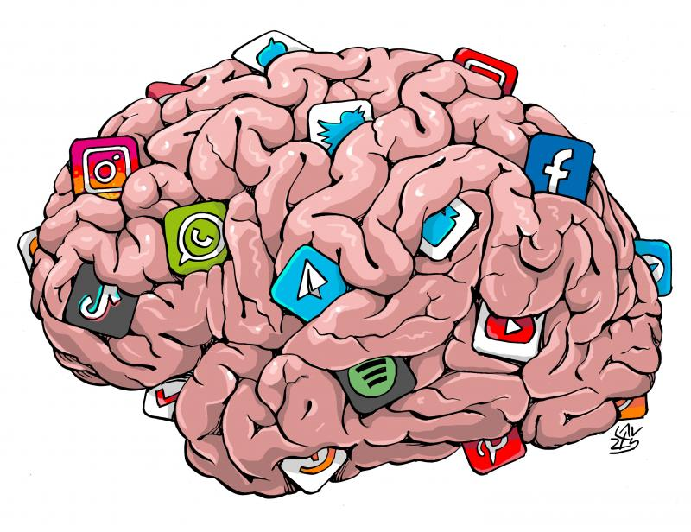
Table of contents
Theoretical Part
Decision Making
Cognitive Control
Social Media
Empirical Part
Discussion
Literature review

Slide 3
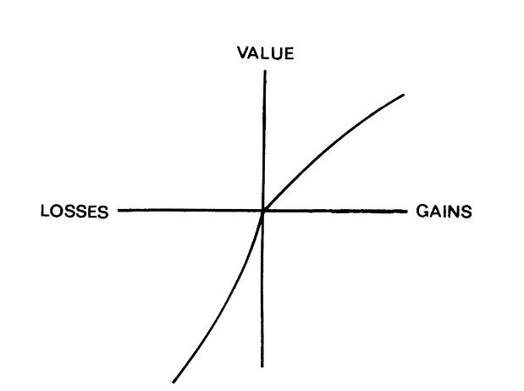
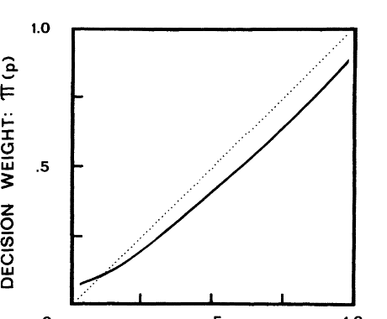
Decision Making – Prospect Theory
Behavioral economic theory developed by Daniel Kahneman and Amos Tversky in 1979
Evaluation phase
Value Function: concave for gains and convex for losses, steeper for losses than for gains.
Reference Point: People evaluate outcomes relative to a reference point, rather than in absolute terms. The reference point is often the status quo or an expectation
Probability Weighting: overestimation of small probabilities and underestimation of large probabilities.
Framing Effects: The way choices are presented (framed) can significantly affect decisions.
Notes:
Prospect Theory, developed by Kahneman and Tversky, provides a powerful framework for understanding how people make decisions under risk and uncertainty, revealing that our choices aren't always as rational as traditional economics suggests.
The authors divided the decision-making process into two cognitive phases for assessing alternatives: the editing phase and the subsequent evaluation phase. I’m going to first present the evaluation phase.
One of the core ideas is the Value Function:
The value function is concave for gains and convex for losses, which implies diminishing sensitivity. This means that the pain of losing is more intense than the pleasure of gaining, even if the amounts are equivalent. The value function is also steeper for losses than for gains, indicating loss aversion.
Another key concept is the Reference Points:
People evaluate outcomes relative to a reference point, rather than in absolute terms. So is where we measure outcomes and whether we see them as gains or losses.
Probability Weighting:
We don’t perceive probabilities accurately—tending to overestimate small chances and underestimate large ones.This leads to risk-averse behavior in the domain of gains and risk-seeking behavior in the domain of losses.
Framing Effects:
The way choices are presented (framed) can significantly affect decisions. People are influenced by whether a scenario is framed in terms of potential gains or losses, even if the underlying outcomes are identical.
(Shorter : Prospect Theory reveals that our decision-making under risk isn’t always rational. It centers on the value function, showing that we feel losses more intensely than gains—this is loss aversion. Decisions are influenced by our reference point, which determines whether we see outcomes as gains or losses, and framing, where the way choices are presented can change our preferences.
Probability weighting also plays a role, where we overestimate small chances and underestimate large ones.
)

Slide 4

Decision Making – Prospect Theory
Editing phase
Coding
Simplification
Combining and Segregating
Detection of Dominance
Notes:
Now, within this framework, the editing phase simplifies complex decisions through several cognitive processes:
Coding frames outcomes relative to the reference point, deeply affecting our risk perception.
Simplification involves rounding probabilities or ignoring unlikely outcomes, which can distort judgments.
Combining and segregating involve merging similar outcomes or separating riskless parts from risky ones.
Detection of dominance allows us to eliminate inferior options, but can sometimes lead to preference reversals.
These cognitive processes, while simplifying our decisions, can introduce biases, leading to inconsistencies in our choices. Understanding these concepts helps us better navigate the complexities of decision-making, revealing the often irrational nature of our choices under risk and uncertainty.
(Shorter :In the editing phase, we simplify decisions through processes like coding, framing outcomes relative to a reference point; simplification, rounding probabilities or ignoring unlikely outcomes; combining and segregating similar outcomes; and detection of dominance, eliminating inferior options.)

Slide 5
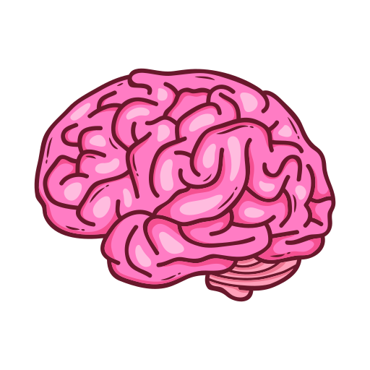

Cogntive control
Cognitive control enables:
problem-solving,
decision-making,
maintaining information,
suppressing habitual behavior based on habit.
It is associated with various processes, such as:
working memory activation,
problem-solving,
reasoning,
goal setting
execution.
In financial decision-making, cognitive control impacts risk-taking
Notes:
Cognitive control is crucial for problem-solving and decision-making, adapting to new challenges, maintaining information, and suppressing behavior based on habit. It is associated with various processes, such as working memory activation, problem-solving, reasoning, goal setting, and execution.
In financial decision-making, cognitive control plays a key role in the coding phase of Prospect Theory, where we frame outcomes as gains or losses relative to a reference point. It helps us assess and evaluate risks, control impulses, resist immediate gratification, and regulate emotions.
Essentially, cognitive control aligns our decisions with our goals, focusing on relevant information and managing distractions.

Slide 6

Cogntive control
Dysfunction in brain areas responsible for cognitive control can disrupt decision-making.
Decision-making is influenced by two key neural systems:
reward approach system: system motivates us to take risks by activating dopamine pathways
loss avoidance system: drives us to avoid risks to prevent potential negative outcomes
Notes:
Dysfunction in brain areas responsible for cognitive control can disrupt decision-making. Even among healthy individuals, differences in cognitive control affect decision quality. Those with stronger cognitive control make more rational decisions and consider long-term outcomes better.
Decision-making is influenced by two key neural systems: the reward approach system and the loss avoidance system. The reward approach system motivates us to take risks by activating dopamine pathways, giving us that pleasurable and reinforcing sensation. On the other hand, the loss avoidance system drives us to avoid risks to prevent potential negative outcomes. These two systems work together to shape our choices, balancing our pursuit of rewards with the need to avoid losses. When we get that dopamine boost from taking risks, our brains may push us to seek out similar rewarding experiences.

Slide 7


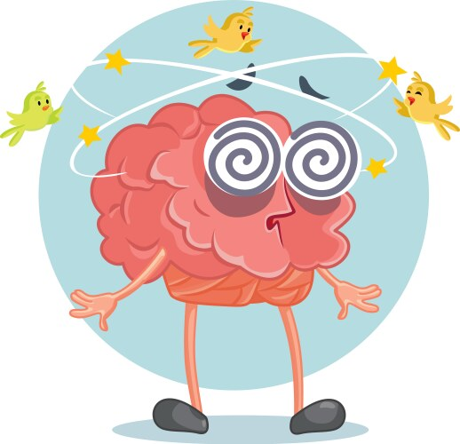

Social Media Usage
Oxford Dictionary : ”websites and applications enabling users to create and share content or to participate in social networking."
These platforms satisfy our fundamental social needs
Release dopamine
Excessive social media use can hurt our cognitive control
Notes:
In the digital age, social media has become a dominant force, transforming communication and connection.
The Oxford Dictionary defines social media as "websites and applications enabling users to create and share content or to participate in social networking."
These platforms tap into fundamental social needs, such as the drive to belong and manage social reputation, which are crucial for survival and social success.
Research highlights how social media satisfies these needs by providing social validation. For example, when we get "Likes,” our brain’s reward system lights up, especially in frequent users.
Dopamine, the brain’s pleasure chemical, is released when we receive social media feedback, reinforcing our use of these platforms and makes us seek more rewards and even take risks. Studies also show that heavy social media use can lead to smaller volumes in brain areas linked to reward and impulsivity.
Excessive social media use can hurt our cognitive control by causing distractions and reducing our ability to focus.
Constant exposure and multitasking can overload working memory, impair decision-making, and diminish impulse control .Emotional regulation challenges during social media use can further affect cognitive functioning.
Overall, as social media becomes more embedded in our lives, understanding its impact on our brain and behavior is increasingly important.

Slide 8
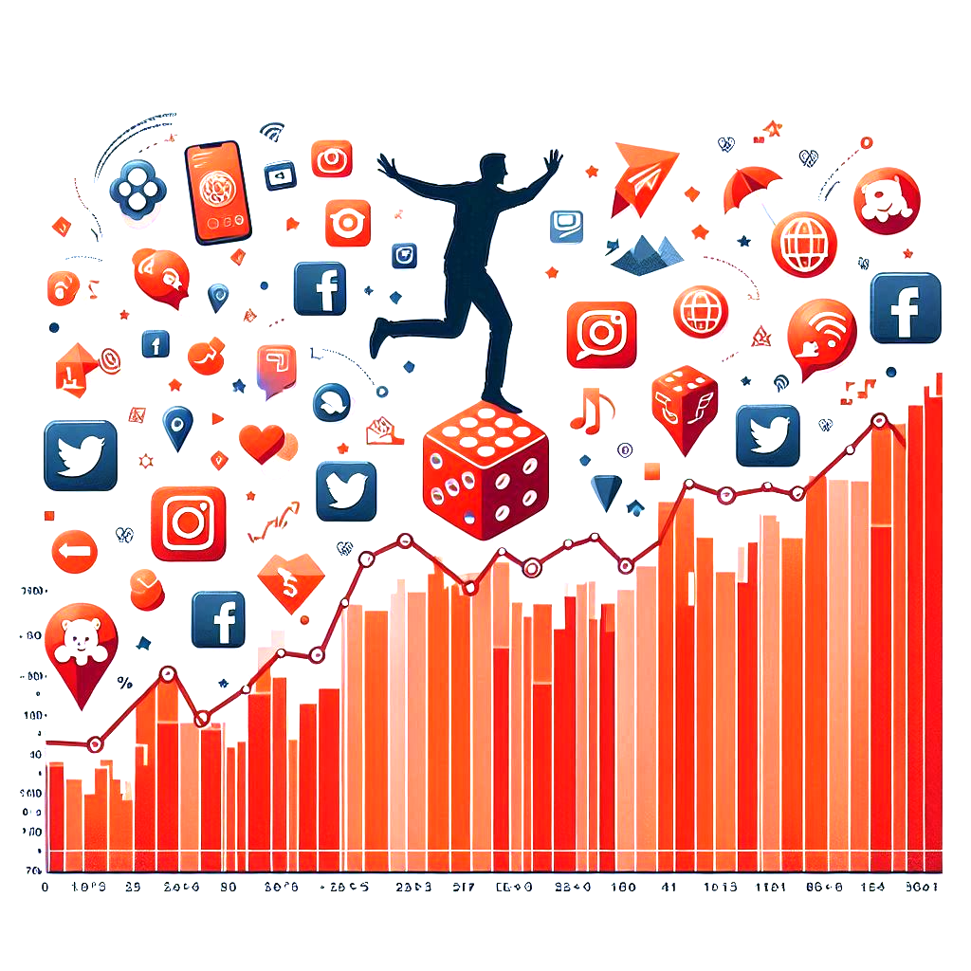
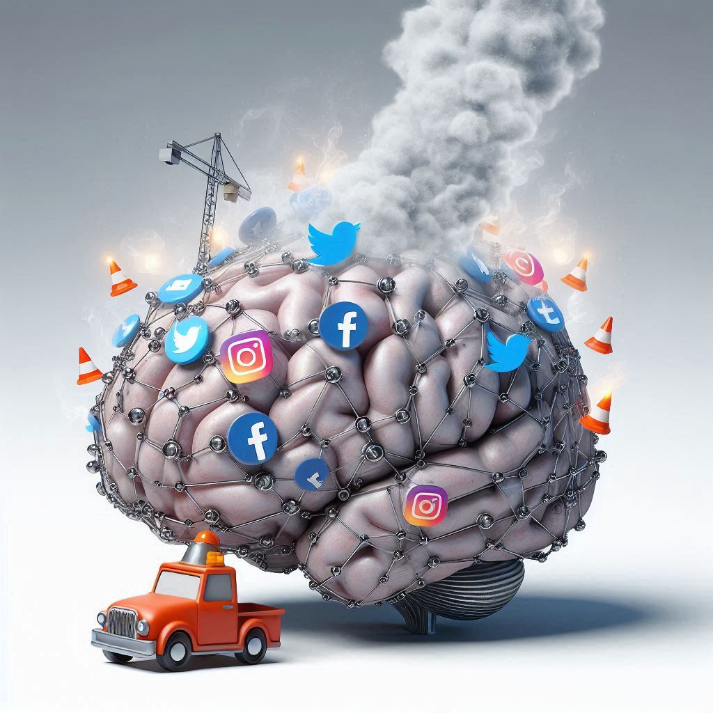
Hypothesis
Hypothesis 1: Increased social media usage is positively correlated with higher risk-taking behavior.
Hypothesis 2: Increased social media usage negatively affects cognitive control.
Notes:
Social media platforms have become central to our lives, influencing not just how we interact, but also how we think and make decisions.
These platforms tap into our brain's reward system, releasing dopamine whenever we receive likes, comments, or shares—similar to the pleasure we get from risky activities. This constant dopamine boost could lead us to seek out more exciting and potentially risky experiences in other parts of our lives.
Social media also impacts our cognitive control, which includes our ability to focus, resist impulses, and manage information. The rapid flow of information and constant notifications on these platforms can overwhelm our attention, making it harder to concentrate and more difficult to control impulses. Over time, this could weaken our ability to focus and resist distractions, leading to poorer decision-making.
In my research, I propose two hypotheses: First, that increased social media use is linked to greater risk-taking behavior. Second, that it negatively impacts cognitive control, reducing our ability to focus and manage distractions effectively.
In essence, the constant stimulation from social media might be driving us toward riskier behaviors while also making it harder for us to stay focused and control our impulses.

Slide 9
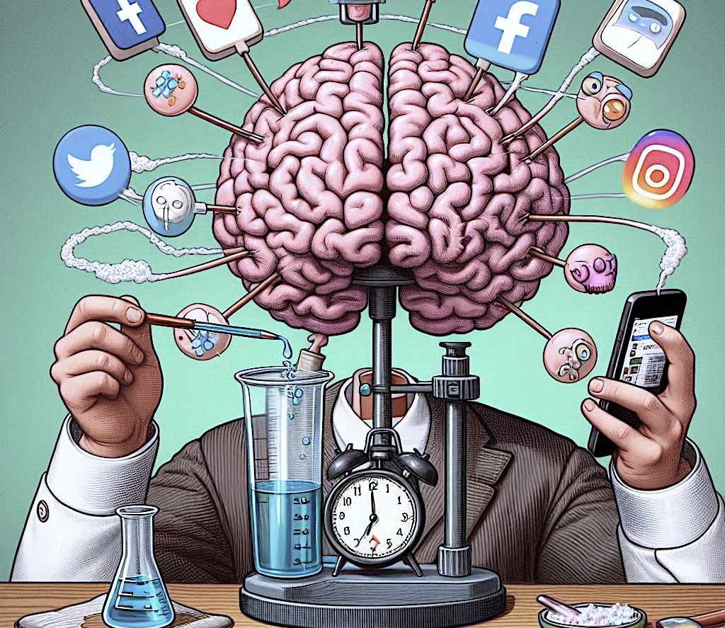
EMPIRICAL PART
Experiment was done it two parts:
Survey:
Online platform 1-ka
543 subjects , 212 males, 329 females
Risk taking tasks
Social Media Usage
Cognitive control task:
online psychological testing platform Millisecond
91 subjects, comprised of 35 males and 56 females.
Child Flanker Fish Task
Notes:
The experiment was done in two parts
The crucial element of the study was connecting the individual results from both parts. Participants were instructed to make up their own 7-digit identification code (ID) to insure the data anonymity. The ID had to contain four letters and three numbers. However, some subjects had problems recalling their ID when they needed to enter it in the second part of the experiment. Therefore, not all IDs could be matched.
Part was the Survey. Here we had more than 600 submissions.To ensure the reliability and integrity of the data we took out the inappropriate sumbissions. First we took only the ones that were completed. Additionally, we excluded submissions made after the 17th of June, those completed in less than 5 minutes, subjects who did not specify their sex, only ages between 20 and 25, and those reporting less than 20 minutes or more than 10 hours of social media usage per day
Part was dedicated to Cognitive Control measurement . The flanker task recorded 174 submissions After cleaning the data and merging the data from the two parts by matching identification codes, the final dataset includes 91 subjects, comprised of 35 males and 56 females

Slide 10
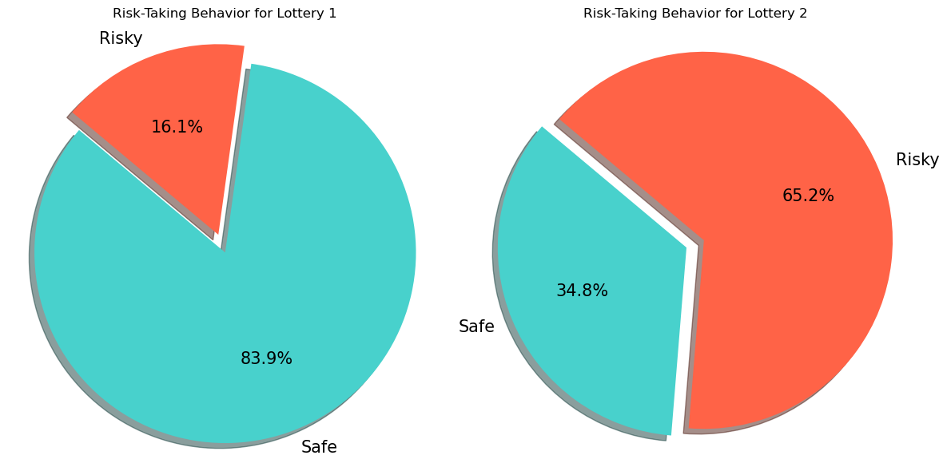
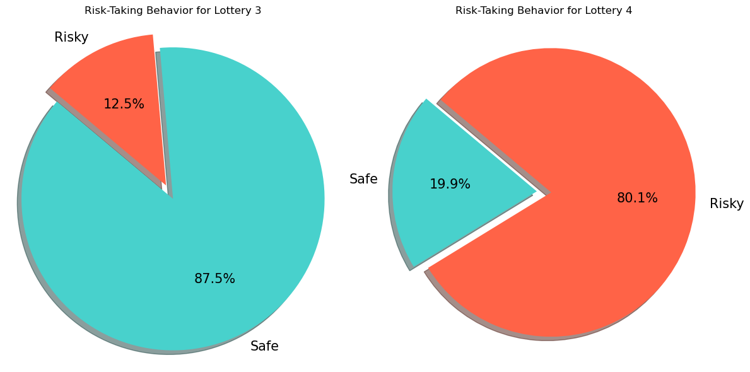
Lotteries
Lottery 1: A: Win 4,000 EUR with an 80% probability B: Win 3,000 EUR with 100% probability
Lottery 3: A: Win 6,000 EUR with a 45% probability B. Win 3,000 EUR with a 90% probability
Lottery 2: C: Win 4,000 EUR with a 20% probability D: Win 3,000 EUR with a 25% probability
Lottery 4: C: Win 6,000 EUR with a 1% probability D. Win 3,000 EUR with a 2% probability
Notes:
The lotteries were taken from the paper Prospect Theory by D. Kahneman and A. Tversky. The subjects had to answer 4 lotteries
In the first pair reducing the probability of winning from 1.0 to 0.25 has a greater impact than the reduction from 0.8 to 0.2. We confirm this hypothesis with a chi-square test, χ²(3) = 12.91, p <0 .05 In the second pair people prefer the safer option when the outcome is more certain. Whereas the probabilities are just minuscule, they are willing to take on more risk

Slide 11
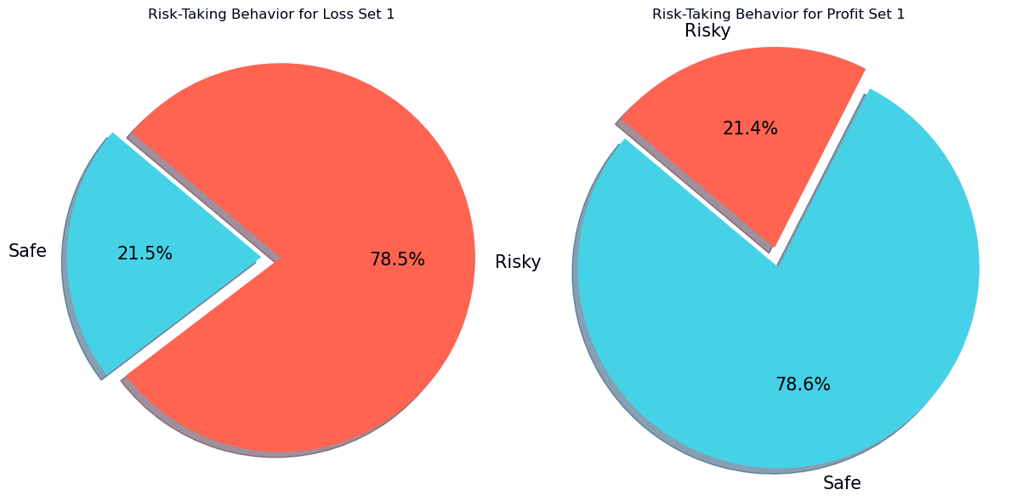
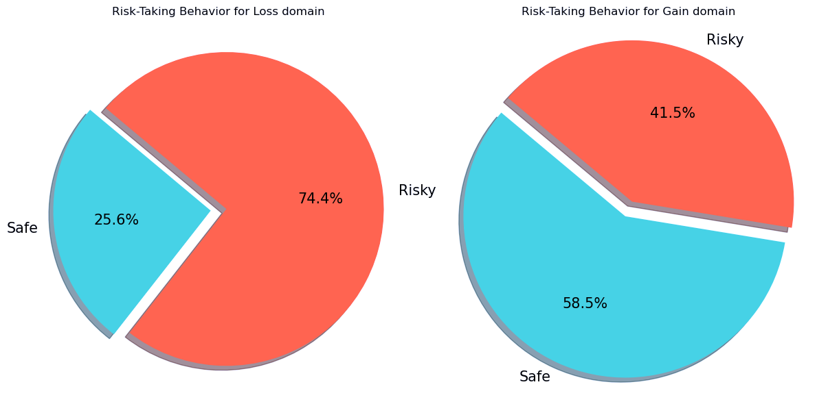
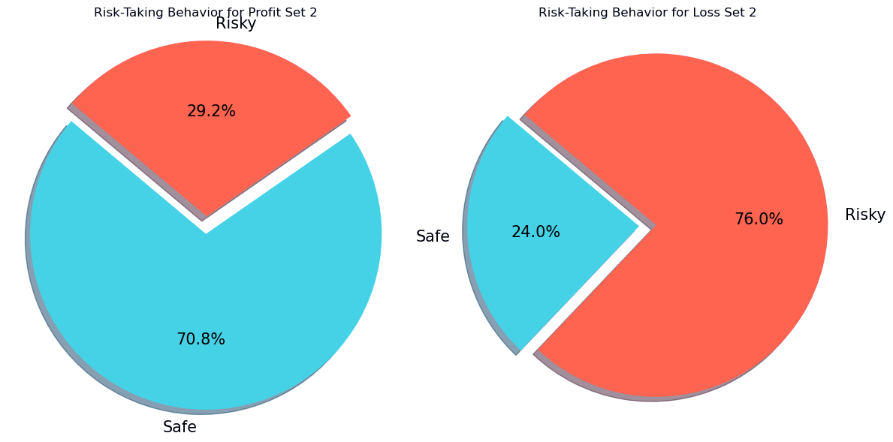
Framing Scenarios
 | Chi-squared | P-value
Profit vs. Loss Set 1 | 143.95 | 3.64e-33
Profit vs. Loss Set 2 | 96.42 | 9.31e-23
TilTec Gain vs Loss | 48.41 | 3.47e-12
Notes:
Next, the participants had to answer regarding two pairs of financial risk-taking lotteries in profit and loss domains,
Consistent with previous research, decisions varied depending on the framing. In the gain domain, the subject preferred the safe option, whereas in the loss domain, they preferred the risky alternative to confirm this we preformed chi-square tests.

Slide 12
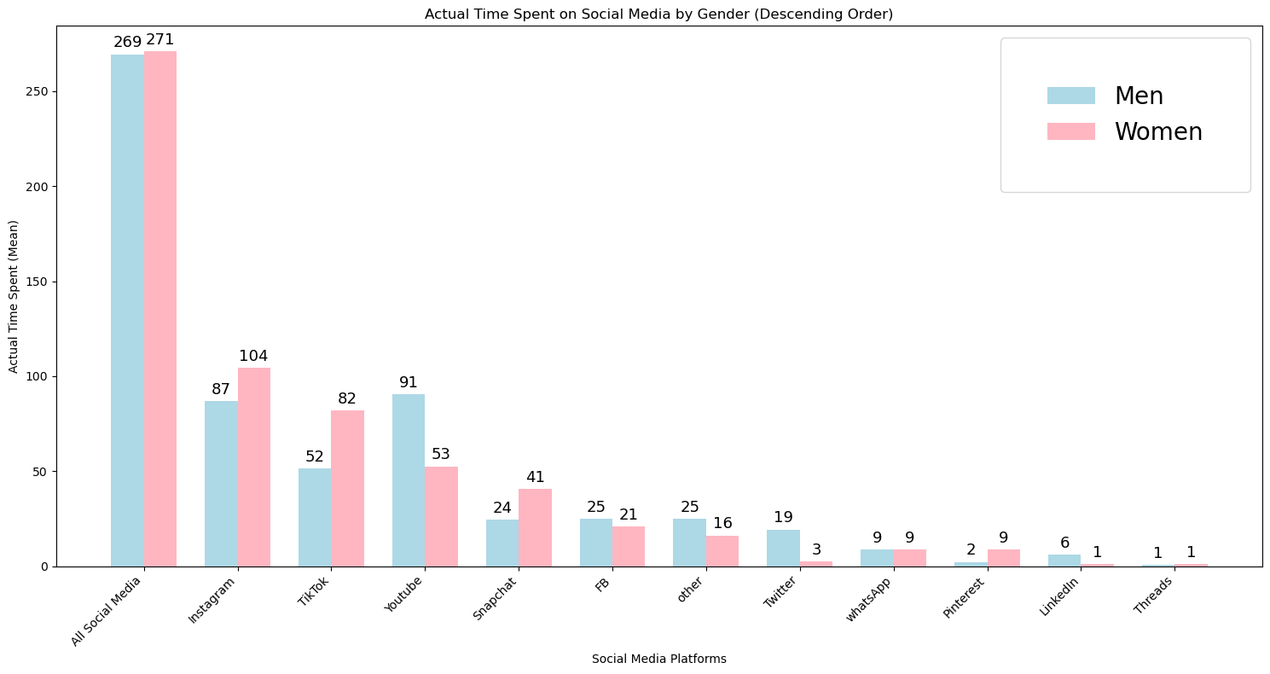
Notes:
There are also gender differences in social media use. Prevoius research has shown that women tend to use social media more for maintaining relationships and are more affected by privacy concerns and social ties. Men might use it more for entertainment like watching videos or following sports.
If we look at our dataset ,we can confirm this tendencies. We can observe that females use Instagram and TikTok more frequently than males . A t-test was conducted to examine the difference in social media usage between males and females, confirming several statistically significant differences. The t-test confirmed that females tend to use more TikTok, Youtube, Snapchat, Pintrest, wheras men tend to use more Youtube, Twitter and Linkdin.

Slide 13

Child’s Flanker Task
cognitive psychology test
examines how distracting stimuli affect attention and conflict resolution
congruent or incongruent trials
The task measured reaction times and error rates
Notes:
The second part of the experiment was dedicated to investigating Cognitive control. To assess it, the subjects had to complete a Flanker Task.
Flanker Task is a cognitive test used to study how distractions affect attention and conflict resolution. Participants focus on a central target, flanked by distractors that can either be congruent (same direction) or incongruent (opposite direction).
The goal is to see how these flankers influence the ability to correctly identify the target.
Research shows that incongruent flankers slow reaction times and increase error rates, highlighting the extra cognitive conflict they cause. In our study, we used a child-friendly version called the Child Flanker Fish Task. Instead of arrows, the task involved fish.

Slide 14
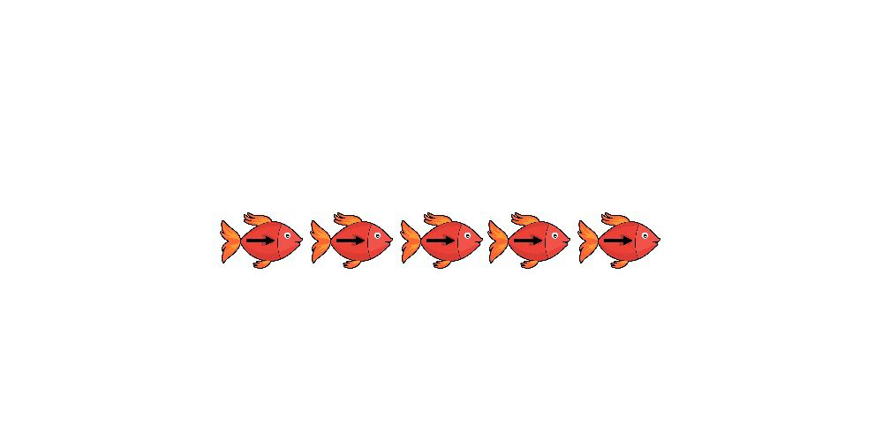
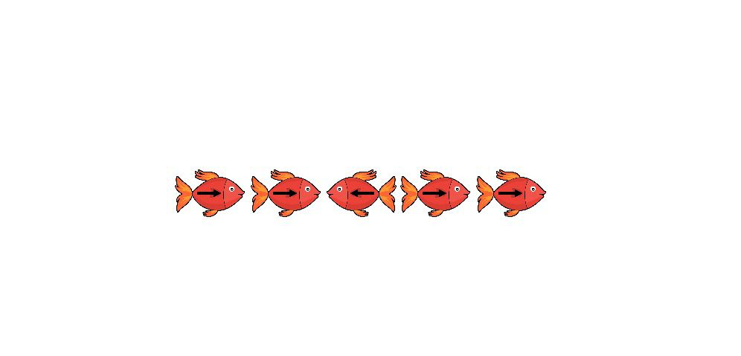


Childs Flanker Task

Slide 15
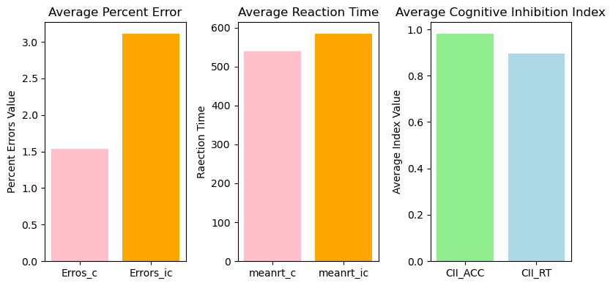
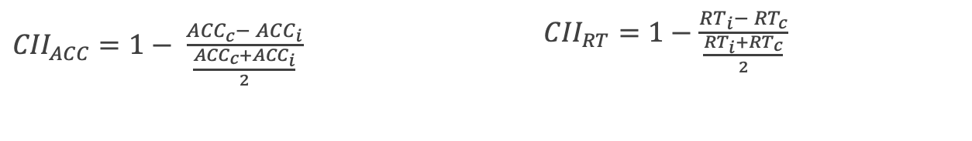
Results
${CII}_{ACC}=1− \frac{{ACC}_{c}− {ACC}_{i}}{\frac{{ACC}_{c}+{ACC}_{i}}{2}}$
${CII}_{RT}=1−\frac{{RT}_{i}− {RT}_{c}}{\frac{{RT}_{i}+{RT}_{c}}{2}}$
Notes:
We calculated a Cognitive Inhibition Index (CII) to assess inhibitory control across different incentive conditions. The CII was derived for both accuracy and reaction times. A perfect score, with no difference between congruent and incongruent trials, would give a CII of 1.
A lower CII indicates weaker cognitive inhibition, meaning greater difficulty in ignoring distractions. The index is normalized by averaging reaction times and accuracy across both trial types, balancing the typical slowing effect of incongruent trials and the enhancing effect of congruent trials
The CII for accuracy is high (close to 1), indicating that participants maintain high accuracy regardless of the presence of distractors. However, the CII for reaction time is 0.89, indicating that participants' reaction times are more affected by the presence of distractors. This suggests weaker cognitive inhibition in terms of reaction time, as participants take longer to respond under incongruent conditions.

Slide 16
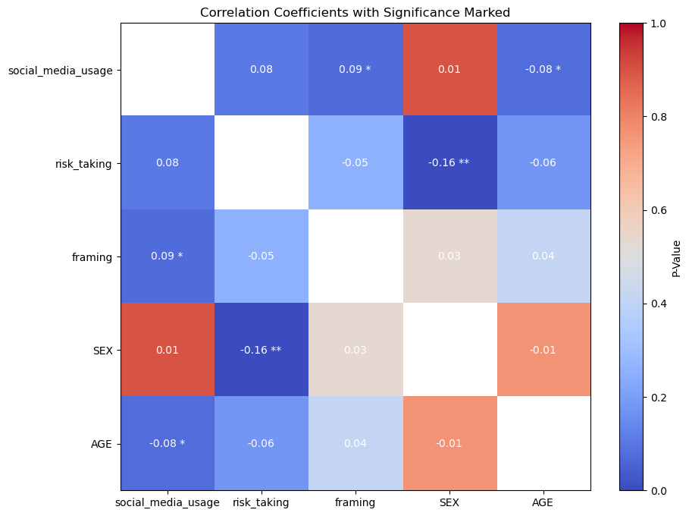
Correlation Heatmap between the Risk-Taking, Framing, and Social media usage
(**) p < 0.05
(*) p < .01
Notes:
In order to analyze risk-taking behavior in our study, we developed two composite variables based on participants' responses to a series of lotteries and scenario-based questions.
First, the "risk-taking" variable measured whether participants leaned towards risky or safe choices. We scored risky choices as 1 and safe choices as 0. Participants who made more risky choices were labeled "risk-inclined" (1), those who chose more safely were "risk-averse" (-1), and those who balanced between the two were classified as "neutral" (0).
Second, we introduced the "framing" variable to assess how the presentation of scenarios (profit vs. loss) influenced risk-taking. Participants were labeled as "neutral" (0) if their choices were evenly split between risky and safe options; otherwise, they were classified as influenced by framing effects (1).
These variables helped us gain a deeper understanding of risk-taking behaviors and the impact of framing on decision-making.
First, to explore and better understand the relationship between the variables, we conducted a correlation analysis.
We can see that risk-taking has a positive correlation with social media usage (0.08) but is not significant, p > 0.1.
Additionally, risk-taking shows a negative correlation with gender (-0.16), significant, p < 0.05. Suggesting, males on average, exhibit slightly higher risk-inclined behavior compared to females in this dataset.
Framing exhibits marginally significant positive correlations with social media usage (0.09), p < 0.1. This means that subjects who spend more time on social media are more prone to frame manipulation and, therefore, change their preferences depending on the frame a problem is presented to them.
Social media usage has a negative correlation with age (-0.08), p < 0.05. This indicates that as age increases, social media usage tends to decrease.

Slide 17
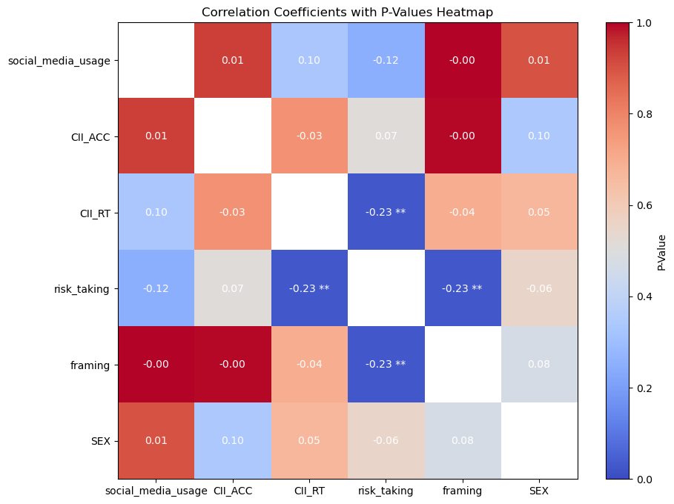
Correlation Heatmap between the Risk-Taking, Framing, Social media usage and Cognitive Control
(**) p < 0.05
(*) p < .01
Notes:
To understand the relationship between the variables related to hypothesis 2, we created this heatmap.
These findings indicate that neither CII for accuracy nor reaction time has significant relationships with social media usage, demographic variables, or each other in this dataset.
However, we can observe a statistically significant negative correlation (-0.21) between CII for reaction time and risk-taking, p < 0.05. This suggests that the weaker the CII for reaction time, the tendency for risk-taking behavior increases.
Interestingly, risk-taking also shows a significant negative correlation with framing (-0.23), p < 0.05. This relationship implies that individuals who are more susceptible to framing effects tend to exhibit lower levels of risk-taking behavior.

Slide 18
Logistic Regression for Risk-taking
Hypothesis 1: The effect of social media usage on risk-taking behavior – Increased social media usage is positively correlated with higher risk-taking behavior.
Variable | Coefficient | Std Error | z-value | P>|z|
Social media usage | 0.002 | 0.00 | 2.28 | 0.02
Gender | -0.60 | 0.19 | -3.21 | 0.00
Framing | -0.25 | 0.19 | -1.31 | 0.19
0/1 | -1.32 | 0.41 | -3.21 | 0.00
1/2 | 0.86 | 0.06 | 14.65 | 0.00
Notes:
In Hypothesis 1, we investigated whether increased social media usage positively correlates with higher risk-taking behavior.
To examine the relationship between social media usage and risk-taking behavior while accounting for control variables framing and gender, we performed an ordinal logistic regression analysis. The results of ordinal logistic regression are presented in Table 9. The dependent variable was risk-taking.
The analysis revealed a statistically significant positive coefficient for the variable social media usage, β = 0.002, p < 0.05, suggesting that individuals with higher social media usage are more likely to exhibit risk-inclined behavior compared to those with lower social media usage. This confirms our hypothesis.
The coefficient for gender is statistically significant, β = - 0.60, p < 0.01. The negative coefficient indicates that being female is associated with a lower likelihood of being in a higher risk-taking category compared to being male.
Framing has a p > 0.05, indicating that this effect is not statistically significant, meaning that the framing effect does not have a meaningful impact on risk-taking behavior in this model.
In an ordinal logistic regression, the thresholds divide the continuous latent variable (which represents the propensity to be in a certain category of the outcome) into discrete categories. Threshold 0/1 (-1.32) means that if the latent variable (linear predictor) is less than -1.32, the respondent is more likely to be "risk-averse". If it is greater, they are more likely to be "neutral" unless it is also greater than 0.86. Threshold 1/2 (0.86) means if the latent variable is greater than 0.86, the respondent is more likely to be "risk-taking". The subject is more likely to be risk-neutral if the latent variable is between –1.32 and 0.86.
The analysis reveals a significant association between social media usage and risk-taking behavior, indicating that higher social media usage correlates with more risk-inclined behavior. This relationship is statistically significant at the 5% level (p = 0.05), supporting the proposed Hypothesis 1 that increased social media usage is linked to higher risk-taking.

Slide 19
Linear Regression for Cognitive Inhibition Indexes
Hypothesis 2: Increased social media usage negatively affects cognitive control.
Coefficients: | Estimate | Std. Error | t-value | Pr(>|t|)
(Intercept) | 0.81 | 0.14 | 5.79 | 0.00
Social media usage | 0.00 | 0.00 | 0.99 | 0.33
Age | 0.01 | 0.02 | 0.42 | 0.67
Gender | 0.00 | 0.01 | 0.43 | 0.67
Coefficients: | Estimate | Std. Error | t value | Pr(>|t|)
(Intercept) | 0.90 | 0.06 | 14.18 | 0.00
Social media usage | 0.00 | 0.00 | 0.15 | 0.88
Age | 0.01 | 0.01 | 0.97 | 0.34
Gender | 0.00 | 0.00 | 1.22 | 0.23
Notes:
In Hypothesis 2, we investigated whether increased social media usage negatively affects cognitive control
To better understand the relationship between Flanker task scores and social media usage while controlling for other variables, age and gender, we performed linear regression analysis.
The results for both CII for reaction time and accuracy as a dependent variable show an insignificant effect of Social Media Usage.
Based on the results, we cannot confirm Hypothesis 2.

Slide 20
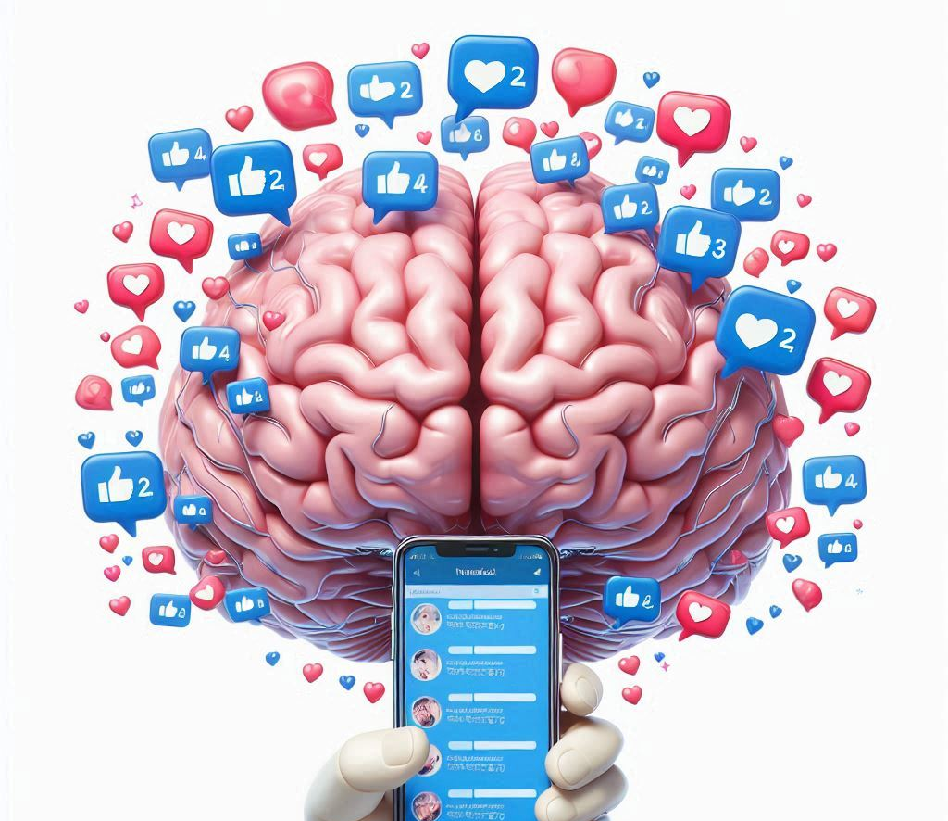
Conclusion
The findings confirm the hypothesis that higher social media usage is associated with increased risk-taking behavior.
Although Hypothesis 2, which proposed that higher social media usage negatively affects cognitive control, was not supported, the results underscore the need to refine and expand cognitive control theories
As the digital landscape continues to evolve, ongoing research in these areas will be crucial for developing strategies to manage social media use and its impact on cognitive and behavioral outcomes.
Notes:
To wrap up, this study delved into the intricate connections between social media use, cognitive control, and risk-taking behavior. We found that heavier social media usage is linked to more risk-taking, suggesting that the instant rewards we get from platforms, could be pushing us toward riskier decisions. However, when it comes to cognitive control—our ability to focus, resist impulses, and manage information—the results were less clear. Despite our expectations, we didn’t find a strong link between social media usage and changes in cognitive control, as measured by tasks like the Flanker Task.
While these findings contribute to our understanding of how digital behaviors might shape our decision-making, they also highlight the complexity of the issue. There are many factors at play, including individual differences and the specific ways people use social media.
This study suggests that more research is needed, particularly with long-term studies and more nuanced approaches like neuroimaging, to fully understand how social media impacts our brains and behavior.
In conclusion, this research adds valuable insights into how our digital lives intersect with cognitive and behavioral processes. As social media continues to be a dominant force in our lives, it’s crucial that we deepen our understanding of its effects and refine our theories to better reflect the realities of our digital age.

Slide 21


Thank you

Slide 22

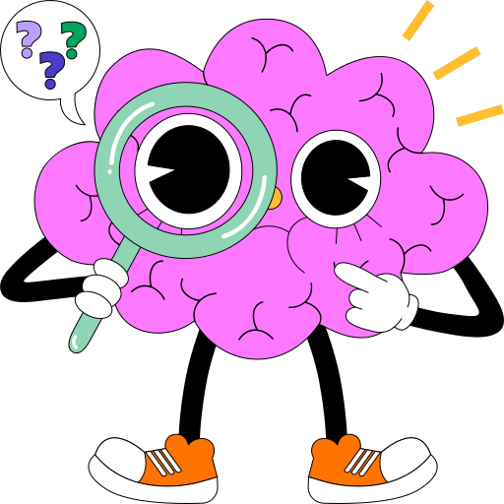

Slide 23
REFERENCE LIST
Anderson, M. C., & Levy, B. J. (2009). Suppressing Unwanted Memories. Current Directions in Psychological Science 18(4).
Ayano, G. (2016). Dopamine: Receptors, Functions, Synthesis, Pathways, Locations and Mental Disorders: Review of Literatures. Journal of Mental Disorders and Treatment. 2. 10.4172/2471-271X.1000120.
Baumeister, R. F., & Leary, M. R. (1995). The need to belong: desire for interpersonal attachments as a fundamental human motivation. Psychological Bulletin, 117(3), 497–529.
Biernatowska, A., Balcerowska, J. M., & Bereznowski, P. (2017). Gender differences in using Facebook—preliminary analysis. In J. Nyćkowiak & J. Leśny (Eds.), Badania i Rozwój Młodych Naukowców w Polsce – Społeczeństwo: psychologia i socjologia, 13-18.
Blaess, S., Stott, S. R. W., & Ang, S.-L. (2020). The generation of midbrain dopaminergic neurons. In Comprehensive Developmental Neuroscience: Patterning and Cell Type Specification in the Developing CNS and PNS (Chapter 23). Elsevier. https://doi.org/10.1016/B978-0-12-814405-3.00017-5
Botvinick, M. M., Braver, T. S., Barch, D. M., Carter, C. S., & Cohen, J. D. (2001). Conflict monitoring and cognitive control. Psychological Review, 108(3), 624-652.
Bozarth, M. A. (1994). Pleasure Systems in the Brain. In D. M. Warburton (Ed.), Pleasure: The Politics and the Reality (pp. 5-14). John Wiley & Sons.
Braver, T. S., Paxton, J. L., Locke, H. S., & Barch, D. M. (2009). Flexible neural mechanisms of cognitive control within human prefrontal cortex. Proceedings of the National Academy of Science, 106(18), 7351-7356.
Breiter, H. C., Aharon, I., Kahneman, D., Dale, A., & Shizgal, P. (2001). Functional imaging of neural responses to expectancy and experience of monetary gains and losses. Neuron, 30(2), 619–639. https://doi.org/10.1016/s0896-6273(01)00303-8.
Bromberg-Martin, E. S., Matsumoto, M., & Hikosaka, O. (2010). Dopamine in motivational control: rewarding, aversive, and alerting. Neuron, 68(5), 815–834. https://doi.org/10.1016/j.neuron.2010.11.022.
Burks, S. V., Carpenter, J. P., Goette, L., & Rustichini, A. (2009). Cognitive Skills Affect Economic Preferences, Strategic Behavior, and Job Attachment. Proceedings of the National Academy of Sciences, 106(19), 7745–7750.
Chang, C., Yen, S.-H., & Duh, R.-R. (2002). An empirical examination of competing theories to explain the framing effect in accounting-related decisions. Behavioral Research in Accounting, 14(1), 35-64.

Slide 24
Cohen, J. D., Braver, T. S., & O'Reilly, R. C. (1996). A computational approach to prefrontal cortex, cognitive control and schizophrenia: recent developments and current challenges. Philosophical transactions of the Royal Society of London. Series B, Biological sciences, 351(1346), 1515–1527. https://doi.org/10.1098/rstb.1996.0138
Cokely, E. T., & Kelley, C. M. (2009). Cognitive abilities and superior decision making under risk: A protocol analysis and process model evaluation. Judgment and Decision Making 4(1), str. 20-33.
Diamond, A. (2013). Executive functions. Annual review of psychology, 64, 135-168.
Dohmen, T., Falk A., Huffman, D., & Sunde U. (2010). Are Risk Aversion and Impatience Related to Cognitive Ability?. American Economic Review ,100(3), 1238–60.
Dohmen, T., Falk, A., Huffman, D., & Sunde, U. (2018). On the Relationship between Cognitive Ability and Risk Preference. Journal of Economic Perspectives, 32(2), 115–134. PMID: 30203932.
Du, J., Kerkhof, P., & Van Koningsbruggen, G. (2019). Predictors of Social Media Self-Control Failure: Immediate Gratifications, Habitual Checking, Ubiquity, and Notifications. Cyberpsychology, Behavior, and Social Networking, 22, 477-485. https://doi.org/10.1089/cyber.2018.0730.
Eagly & W. Wood (Eds.), Social role theory (Vol. 2, pp. 458-476). SAGE Publications Ltd. https://doi.org/10.4135/9781446249222.n49
Elliot, A. J., & Thrash, T. M. (2002). Approach-avoidance motivation in personality: Approach and avoidance temperaments and goals. Journal of Personality and Social Psychology, 82(5), 804–818. https://doi.org/10.1037/0022-3514.82.5.804.
Eriksen, C. W., & Eriksen, B. A. (1974). Effects of noise letters upon the identification of a target letter in a nonsearch task. Journal of Experimental Psychology, 104(3), 379-394. https://doi.org/10.1037/h0036219.
Felton, J., Gibson, B., & Sanbonmatsu, D. (2003). Preference for risk in investing as a function of trait optimism and gender. Journal of Behavioral Finance, 4(1), 33-40. https://doi.org/10.1207/S15327760JPFM0401_05
Firth, J., Torous, J., Stubbs, B., Firth, J. A., Steiner, G. Z., Smith, L., Alvarez-Jimenez, M., Gleeson, J., Vancampfort, D., Armitage, C. J., & Sarris, J. (2019). The "online brain": how the Internet may be changing our cognition. World Psychiatry, 18, 119-129. https://doi.org/10.1002/wps.20617.
Glenn, A. L., Raine, A., Yaralian, P. S., & Yang, Y. (2010). Increased volume of the striatum in psychopathic individuals. Biological Psychiatry, 67(1), 52-80. doi: 10.1016/j.biopsych.2009.06.018
Glimcher, P. W., Camerer, C. F., Fehr, E., & Poldrack, R. A. (2009). Neuroeconomics: Decision Making and the Brain. Elsevier Inc. Published by Elsevier Inc.
Haynes, T. (2018, May 1). Dopamine, smartphones & you: A battle for your time. Harvard University. Retrieved February 28, 2022, from https://sitn.hms.harvard.edu/flash/2018/dopamine-smartphones-battle-time/

Slide 25
Hardies, K., Breesch, D., & Branson, J. (2013). Gender differences in overconfidence and risk taking: Do self-selection and socialization matter? Economics Letters, 118, 442–444. https://doi.org/10.1016/j.econlet.2012.12.004
Herbert, J. (2018). Testosterone, Cortisol and Financial Risk-Taking. Frontiers in Behavioral Neuroscience, 12. https://doi.org/10.3389/fnbeh.2018.00101.
Jeong, S., & Hwang, Y. (2016). Media multitasking effects on cognitive vs. attitudinal outcomes: A meta-analysis. Human Communication Research, 42, 599-618. doi: 10.1111/hcre.12089.
Kahneman, D. (2011). Thinking, Fast and Slow. Farrar, Straus and Giroux.
Kahneman, D., & Tversky, A. (1979). Prospect Theory: An Analysis of Decision under Risk. Econometrica, 47, 263-291.
Kanai, R., Bahrami, B., Roylance, R., & Rees, G. (2012). Online social network size is reflected in human brain structure. Proceedings of the Royal Society B, 279, 1327-1334. http://doi.org/10.1098/rspb.2011.1959.
Knutson, B., & Greer, S. M. (2008). Anticipatory affect: Neural correlates and consequences for choice. Philosophical Transactions of the Royal Society of London. Series B, Biological Sciences, 363(1511), 3771-3786.
Kuhnen, C. M., & Knutson, B. (2005). The neural basis of financial risk taking. Neuron, 47(5), 763–770. https://doi.org/10.1016/j.neuron.2005.08.008
Kuhnen, C. M., & Chiao, J. Y. (2009). Genetic determinants of financial risk taking. PloS one, 4(2), e4362. https://doi.org/10.1371/journal.pone.0004362
Idemudia, C. E., Raisinghani, S. M., Adeola, O., & Achebo, N. (2017). The effects of gender on the adoption of social media: An empirical investigation. 23rd Americas Conference on Information Systems, Boston.
Lamm, C., Pine, D. S., & Fox, N. A. (2013). Impact of negative affectively charged stimuli and response style on cognitive-control-related neural activation: An ERP study. Brain and Cognition, 83, 234–243. https://doi.org/10.1016/j.bandc.2013.07.012
Lavie, N., Hirst, A., de Fockert, J. W., & Viding, E. (2004). Load Theory of Selective Attention and Cognitive Control. Journal of Experimental Psychology: General, 133(3), 339-354. https://doi.org/10.1037/0096-3445.133.3.339.
Lavin, A., Nogueira, L., Lapish, C. C., Wightman, R. M., Phillips, P. E., & Seamans, J. K. (2005). Mesocortical dopamine neurons operate in distinct temporal domains using multimodal signaling. The Journal of neuroscience : the official journal of the Society for Neuroscience, 25(20), 5013–5023. https://doi.org/10.1523/JNEUROSCI.0557-05.2005.
Levin, I. P., Xue, G., Weller, J. A., Reimann, M., Lauriola, M., & Bechara, A. (2012). A neuropsychological approach to understanding risk-taking for potential gains and losses. Frontiers in Neuroscience, 6, 15. doi: 10.3389/fnins.2012.00015.
Levy, J. (1992). An Introduction to Prospect Theory. Political Psychology, 13(2), 171-186.
Ličen, M. (2019). The influence of accountability on managerial myopia. Doctoral disseration. Ekonomska fakulteta, Univerza v Ljubljani.

Slide 26
Lin, X., & Wang, X. (2020). Examining gender differences in people’s information-sharing decisions on social networking sites. International Journal of Information Management, 50, 45–56.
Low B. S. (2015). Why sex matters: A Darwinian look at human behavior. Princeton University Press.
Meshi, D., Morawetz, C., & Heekeren, H. R. (2013). Nucleus accumbens response to gains in reputation for the self relative to gains for others predicts social media use. Frontiers in human neuroscience, 7, 439. https://doi.org/10.3389/fnhum.2013.00439
Meshi, D., Tamir, D., & Heekeren, H. (2015). The Emerging Neuroscience of Social Media. Trends in Cognitive Sciences. https://doi.org/10.1016/j.tics.2015.09.004.
Miendlarzewska, E. A., Kometer, M., & Preuschoff, K. (2019). Neurofinance. Organizational Research Methods, 22(1).
Montag, C., Markowetz, A., Blaszkiewicz, K., Andone, I., Lachmann, B., Sariyska, R., Trendafilov, B., Eibes, M., Kolb, J., Reuter, M., Weber, B., & Markett, S. (2017). Facebook usage on smartphones and gray matter volume of the nucleus accumbens. Behavioural brain research, 329, 221–228. https://doi.org/10.1016/j.bbr.2017.04.035
Nadkarni, A., & Hofmann, S. G. (2012). Why Do People Use Facebook?. Personality and individual differences, 52(3), 243–249. https://doi.org/10.1016/j.paid.2011.11.007
Pan, N., Wang, S., Zhao, Y., Lai, H., Qin, K., Li, J., Biswal, B. B., Sweeney, J. A., & Gong, Q. (2021). Brain gray matter structures associated with trait impulsivity: A systematic review and voxel-based meta-analysis. Human Brain Mapping, 42(7), 2214-2235. https://doi.org/10.1002/hbm.25361.
Park, N., & Lee, H. (2014). Gender differences in social networking on smartphones: A case study of Korean college student smartphone users. International Telecommunications Policy Review, 21(2), 1–18.
Pawlowski, B., Atwal, R., & Dunbar, R. I. M. (2008). Sex differences in everyday risk-taking behavior in humans. Evolutionary Psychology, 6(1), 29–42. https://doi.org/10.1177/147470490800600104.
Peterson, M. D. (2007). Affect and Financial Decision-Making: How Neuroscience Can Inform Market Participants. Journal of Behavioral Finance, 8(2), 70-78. https://doi.org/10.1080/15427560701377448.
Read, D., Loewenstein, G., & Rabin, M. (1999). Choice Bracketing. Journal of Risk and Uncertainty 19, 171–197.
Sherman, L. E., Payton, A. A., Hernandez, L. M., Greenfield, P. M., & Dapretto, M. (2016). The power of the like in adolescence: Effects of peer influence on neural and behavioral responses to social media. Psychological Science, 27(7), 1027–1035. https://doi.org/10.1177/0956797616645673.
Sherman, L. E., Greenfield, P. M., Hernandez, L. M., & Dapretto, M. (2018). Peer Influence Via Instagram: Effects on Brain and Behavior in Adolescence and Young Adulthood. Child development, 89(1), 37–47. https://doi.org/10.1111/cdev.12838
Taylor, L. A., & Creese, I. (2002). Dopamine. In Encyclopedia of the human brain (pp. 115-122). Elsevier. https://doi.org/10.1016/B0-12-227210-2/00122-9.

Slide 27
Turel, O., He, Q., Xue, G., Xiao, L., & Bechara, A. (2014). Examination of neural systems sub-serving Facebook "addiction". Psychological Reports, 115, 675-95. https://doi.org/10.2466/18.PR0.115c31z8.
Wang, Y., Peng, X., & Hu, X. (2022). Investigating the Neural Bases of Risky Decision Making Using Multi-Voxel Pattern Analysis. Brain Sciences, 12(11), 1488. https://doi.org/10.3390/brainsci12111488
Weber, E. U., Blais, A.-R., & Betz, N. E. (2002). A domain-specific risk-attitude scale: Measuring risk perceptions and risk behaviors. Journal of Behavioral Decision Making, 15(4), 263-290. https://doi.org/10.1002/bdm.414
Whelan, E., Islam, N., & Brooks, S. (2017). Cognitive control and social media overload. AIS Electronic Library (AISeL).
Wilmer, H. H., Sherman, L. E., & Chein, J. M. (2017). Smartphones and Cognition: A Review of Research Exploring the Links between Mobile Technology Habits and Cognitive Functioning. Frontiers in Psychology, 8, 605. https://doi.org/10.3389/fpsyg.2017.00605.
Wilson, M., & Daly, M. (1985). Competitiveness, risk taking, and violence: The young male syndrome. Ethology & Sociobiology, 6(1), 59–73. https://doi.org/10.1016/0162-3095(85)90041-X.
Yamaguchi, M., & Nishimura, A. (2019). Modulating proactive cognitive control by reward: Differential anticipatory effects of performance-contingent and non-contingent rewards. Psychological Research, 258-274.

